Slide 1
Modernizing SQL Server the Right Way
Strategies, Guides and Tools
Allan Fong, DBA Manager, BAC Credomatic
Notes:
Use this slide as the title slide > if the title is very long, use the second option
1

Slide 2


Allan Fong
Experience
Over 13 years in IT, 9 on Database Administration.
Operated with Regional and International (USA) Operations.
Worked with SQL Server, Oracle, MySQL and MongoDB databases.
DBA Manager, BAC Credomatic
Community
/fong
Guatemala SQL Server User Group Staff Member
@omegagt
Allan Fong
allan@fong.be

Slide 3
Upgrade Process
Notes:
© Microsoft Corporation. All rights reserved. MICROSOFT MAKES NO WARRANTIES, EXPRESS, IMPLIED OR STATUTORY, AS TO THE INFORMATION IN THIS PRESENTATION.
25/06/2019 6:43 p. m.
3

Slide 4
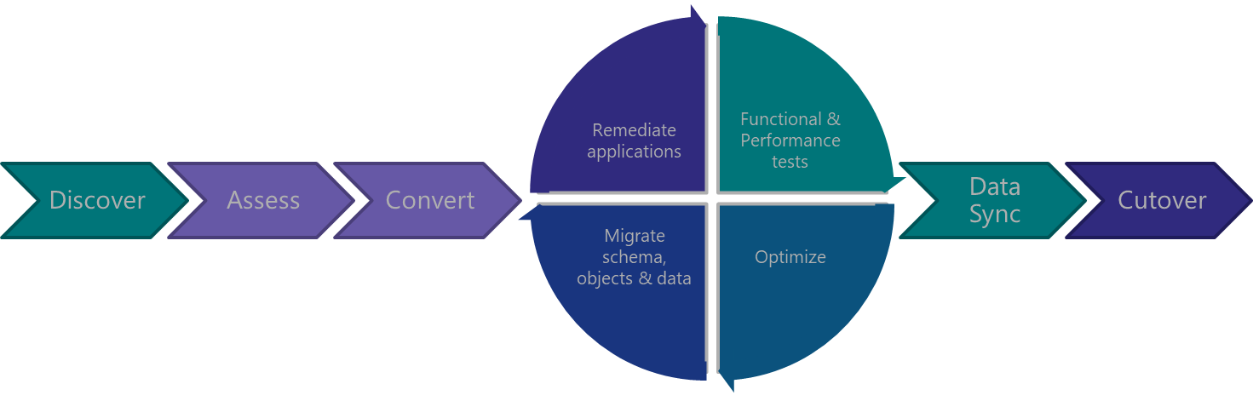
Minimize Risk with the Database Migration Guide
Notes:
Migrations should be approached with the same rigor and processes as a full software or hardware project – a solid methodology is required for success. Microsoft provides you with all the tools you need to achieve a seamless, reliable upgrade experience.
Share the Database Migration Guide with your customers for step-by-step guidance on reliable upgrade methodology.
https://datamigration.microsoft.com/scenario/sql-to-sqlserver
© Microsoft Corporation. All rights reserved. MICROSOFT MAKES NO WARRANTIES, EXPRESS, IMPLIED OR STATUTORY, AS TO THE INFORMATION IN THIS PRESENTATION.
25/06/2019 6:43 p. m.
4

Slide 5
Review the Database Migration Guide for details
Reliable Upgrades
Discover
“With tools like Database Migration Assistant and Database Experimentation Assistant, we were able to reduce the time and effort required for the upgrade, enable automated A/B testing capability to minimize risk and provide a high confidence upgrade plan for a mission critical, Tier-1 environment spanning over a 1000 instances of SQL Server within 3 months.”
Salesforce – PASS Summit 2017
Microsoft Assessment and Planning Toolkit (MAP)
Assess
Data Migration Assistant (DMA)
Fully automated using free tools from Microsoft
Test
Database Experimentation Assistant (DEA)
Notes:
Link in slide: https://datamigration.microsoft.com/scenario/sql-to-sqlserver
Source for quote?
© Microsoft Corporation. All rights reserved. MICROSOFT MAKES NO WARRANTIES, EXPRESS, IMPLIED OR STATUTORY, AS TO THE INFORMATION IN THIS PRESENTATION.
25/06/2019 6:43 p. m.
5

Slide 6
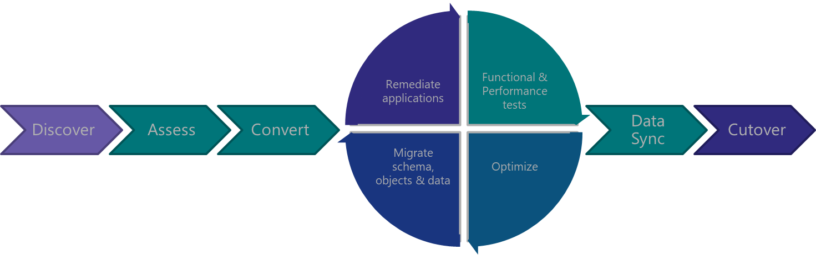
Discover
Notes:
© Microsoft Corporation. All rights reserved. MICROSOFT MAKES NO WARRANTIES, EXPRESS, IMPLIED OR STATUTORY, AS TO THE INFORMATION IN THIS PRESENTATION.
25/06/2019 6:43 p. m.
6

Slide 7
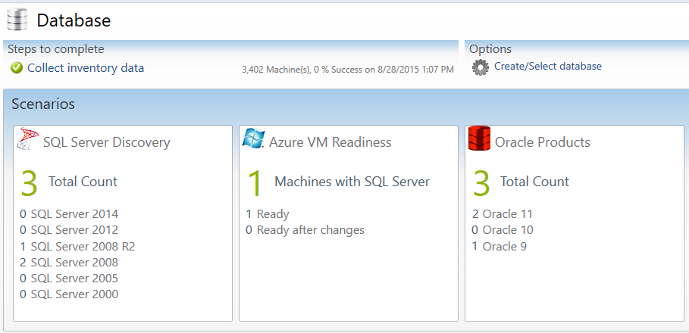
Discover with MAP Toolkit
Which SQL Server versions do I have?
Which Editions am I running?
Which SQL Server components are installed?
How many cores are on each server?
How many databases are in each instance?
What are the sizes of all my databases?
What are the settings for each instance and database?
Notes:
The Microsoft Assessment and Planning Toolkit (MAP) is an agentless, automated, multi-product planning and assessment tool for quicker and easier desktop, server and cloud migrations. MAP can be used to provide an inventory of all your database servers, including installed components, database details, settings and capacity planning information. This Solution Accelerator provides a powerful inventory, assessment, and reporting tool to simplify the migration planning process.
There are 8 areas that the Microsoft Assessment and Planning Toolkit (MAP) toolkit assesses:
Cloud
Desktop
Server
Desktop Virtualization
Server Virtualization
Database
Usage Tracking
Environment
© Microsoft Corporation. All rights reserved. MICROSOFT MAKES NO WARRANTIES, EXPRESS, IMPLIED OR STATUTORY, AS TO THE INFORMATION IN THIS PRESENTATION.
25/06/2019 6:43 p. m.
7

Slide 8
Assess & Convert
Notes:
© Microsoft Corporation. All rights reserved. MICROSOFT MAKES NO WARRANTIES, EXPRESS, IMPLIED OR STATUTORY, AS TO THE INFORMATION IN THIS PRESENTATION.
25/06/2019 6:43 p. m.
8

Slide 9

Assess & Convert with DMA
“Upgrade readiness assessment was delivered with the help of Database Migration Assistant which helped us analyze our template databases to identify potential pitfalls and suggested automated remediation for our development teams to act on.”
Salesforce – PASS Summit 2017
Assess Compatibility Issues
Breaking changes
Behavior changes
Deprecated features
Data Migration Assistant
Discover new features
Performance
Storage
Security
Perform Migration
Connect to source and target servers
Choose databases
Monitor migration
Review final report
Notes:
Data Migration Assistant (DMA) detects compatibility issues that can impact database functionality on your new version of SQL Server. It recommends performance and reliability improvements for your target environment. It allows you to not only move your schema and data, but also uncontained objects from your source server to your target server. Once the assessment is complete and issues have been mitigated, the DMA will automate the process of migrating your schema and data to the target instance.
Source for quote?
© Microsoft Corporation. All rights reserved. MICROSOFT MAKES NO WARRANTIES, EXPRESS, IMPLIED OR STATUTORY, AS TO THE INFORMATION IN THIS PRESENTATION.
25/06/2019 6:43 p. m.
9

Slide 10
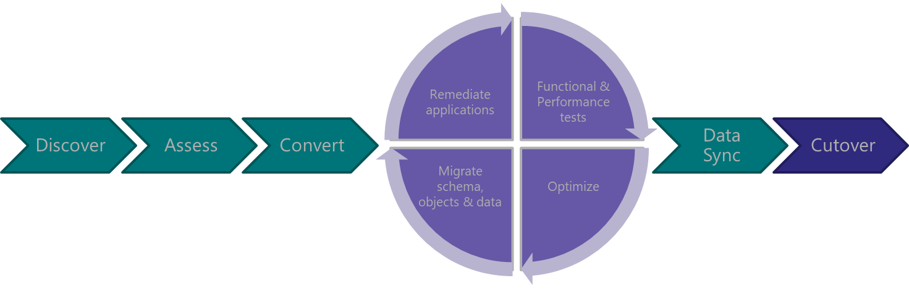
Test &
Optimize
Notes:
© Microsoft Corporation. All rights reserved. MICROSOFT MAKES NO WARRANTIES, EXPRESS, IMPLIED OR STATUTORY, AS TO THE INFORMATION IN THIS PRESENTATION.
25/06/2019 6:43 p. m.
10

Slide 11

Test & Optimize with DEA
A/B testing
“Database Experimentation Assistant helped us perform comparison tests between our current environment and a test SQL Server 2016 environment to identify regressions, breaking changes and performance characteristics.
Because of the automation, we were able to repeat such an exercise with multiple iterations using different configuration settings.”
Salesforce – PASS Summit 2017
Configuration setting comparison
Compatibility execution errors
Database Experimentation Assistant
Hardware comparison
Degraded queries
Workload comparison
Notes:
Database Experimentation Assistant (DEA) is an A/B testing solution for SQL Server upgrades. It will assist in evaluating a targeted version of SQL for a given workload. Customers who are upgrading from previous SQL Server versions (SQL Server 2005 and above) to any new version of the SQL Server will be able to use these analysis metrics.
DEA allows:
Automated script to set up workload capture and replay of production database (using existing SQL server functionality Distributed Replay & SQL tracing).
Perform statistical analysis on traces collected using both old and new instances.
Visualize data through detailed reports.
Source for quote?
© Microsoft Corporation. All rights reserved. MICROSOFT MAKES NO WARRANTIES, EXPRESS, IMPLIED OR STATUTORY, AS TO THE INFORMATION IN THIS PRESENTATION.
25/06/2019 6:43 p. m.
11

Slide 12
Walkthrough
Microsoft Assessment and Planning Toolkit

Slide 13
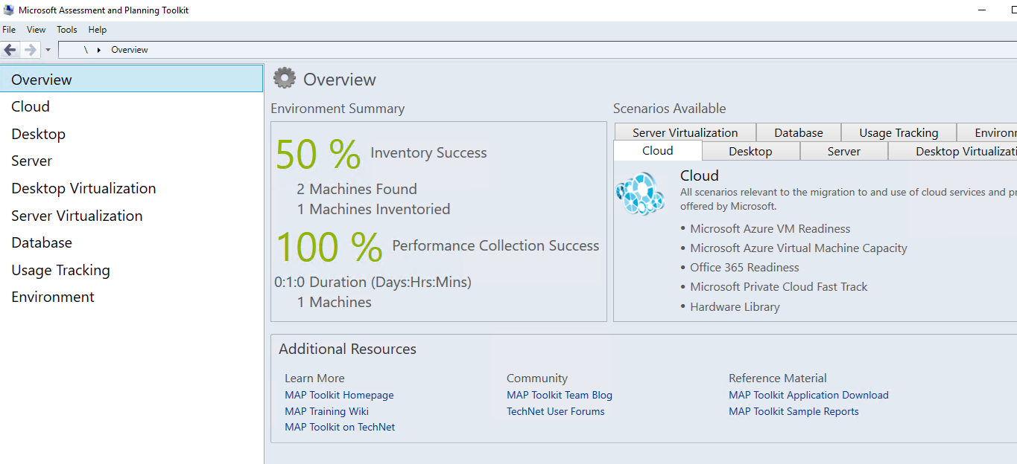

Slide 14
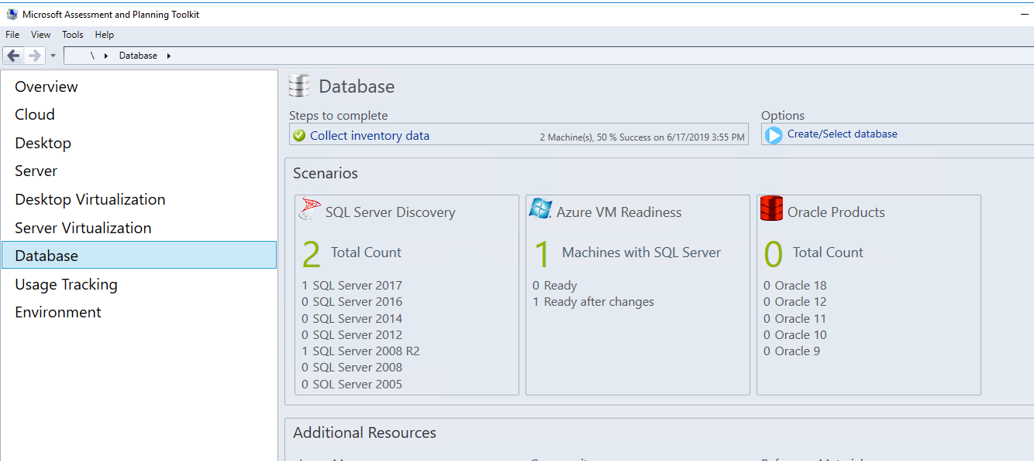

Slide 15
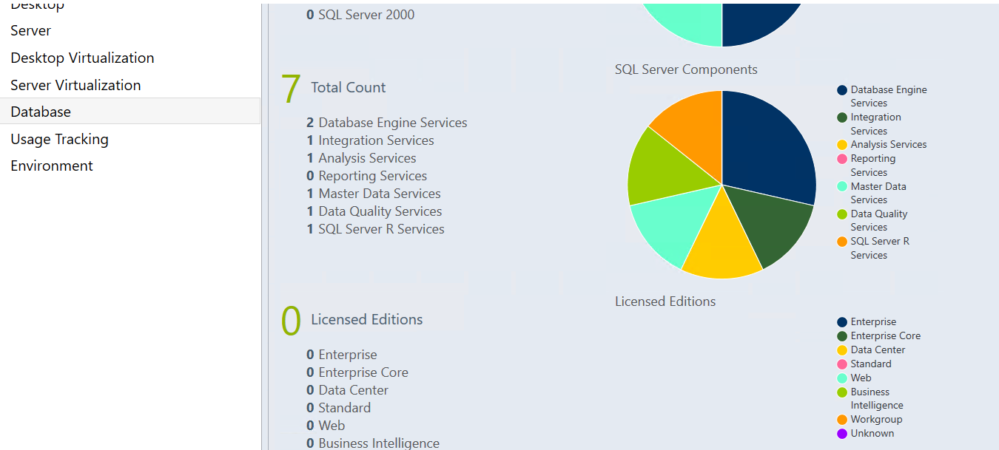

Slide 16


Demo
Notes:
[Moderator to Address questions in order of relevance]
[move to next slide]
Coming up next…

Slide 17
Walkthrough
Database Experimentation Assistant

Slide 18
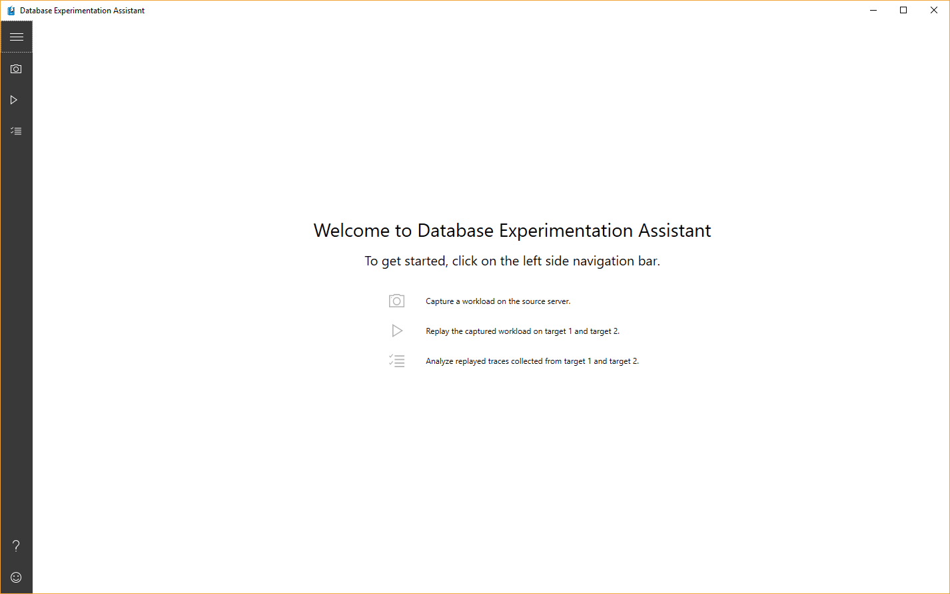
Notes:
After opening, click on “Analyze traces”
© Microsoft Corporation. All rights reserved. MICROSOFT MAKES NO WARRANTIES, EXPRESS, IMPLIED OR STATUTORY, AS TO THE INFORMATION IN THIS PRESENTATION.
25/06/2019 6:43 p. m.
18

Slide 19
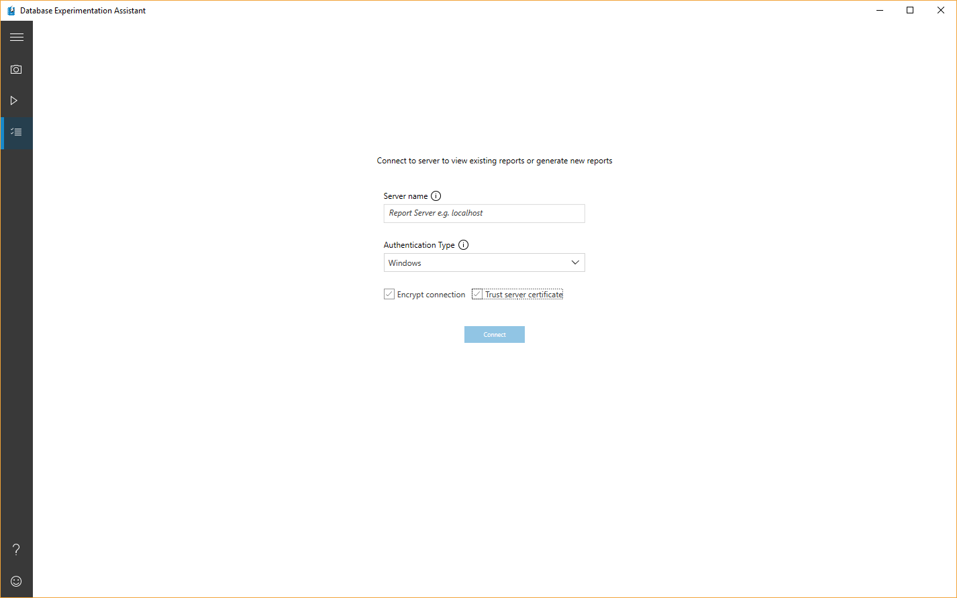
Notes:
Then input server (we’re using localhost) and we’re using the option to trust server cert.
© Microsoft Corporation. All rights reserved. MICROSOFT MAKES NO WARRANTIES, EXPRESS, IMPLIED OR STATUTORY, AS TO THE INFORMATION IN THIS PRESENTATION.
25/06/2019 6:43 p. m.
19

Slide 20
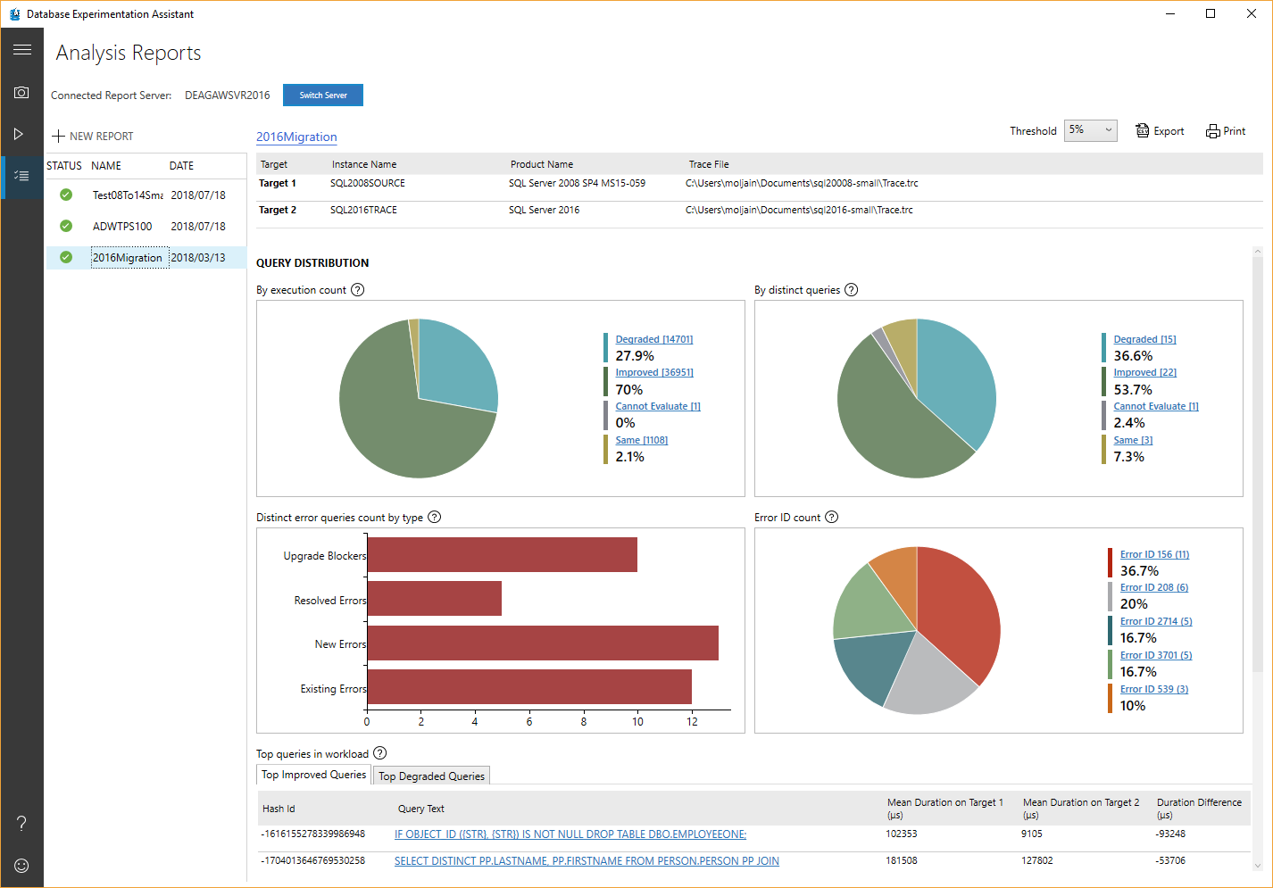
Notes:
Once we select one of the previous replays we’ve done, the report shows up.
© Microsoft Corporation. All rights reserved. MICROSOFT MAKES NO WARRANTIES, EXPRESS, IMPLIED OR STATUTORY, AS TO THE INFORMATION IN THIS PRESENTATION.
25/06/2019 6:43 p. m.
20

Slide 21
Notes:
We see we have a number of potential upgrade blockers. Click on the bar to see details.
© Microsoft Corporation. All rights reserved. MICROSOFT MAKES NO WARRANTIES, EXPRESS, IMPLIED OR STATUTORY, AS TO THE INFORMATION IN THIS PRESENTATION.
25/06/2019 6:43 p. m.
21

Slide 22
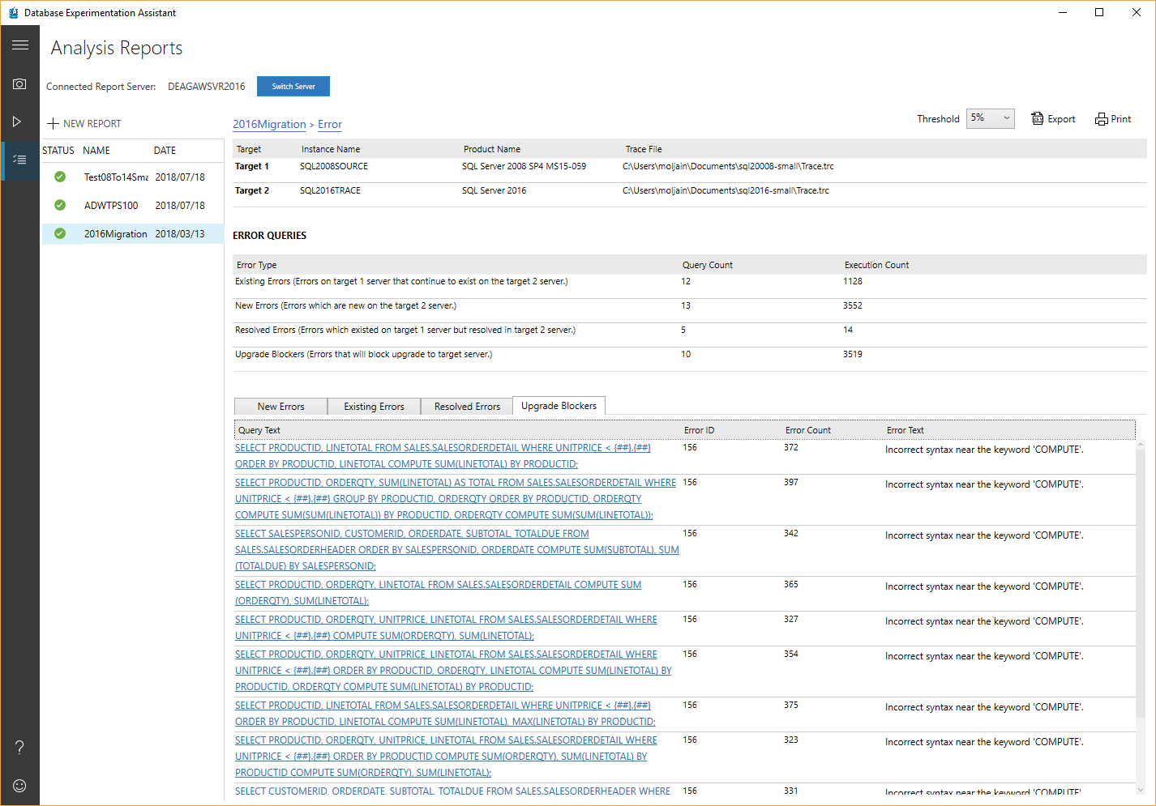
Notes:
The Upgrade Blockers tab shows any syntax execution errors that existed in the replay (B) that didn’t exist in the source (A). Syntax errors mapping to discontinued T-SQL are listed, in the context of the statement that produced the error. In this case, the “COMPUTE” clause was discontinued (back in SQL 2012), so this issue needs addressing.
© Microsoft Corporation. All rights reserved. MICROSOFT MAKES NO WARRANTIES, EXPRESS, IMPLIED OR STATUTORY, AS TO THE INFORMATION IN THIS PRESENTATION.
25/06/2019 6:43 p. m.
22

Slide 23
Modernization Tools Breakdown
DMA
DEA
QTA
Readiness assessment: blocking issues breaking changes, behavior changes
A/B Testing
Upgrade Database Compatibility Model to desired state
Moves schema, data and uncontained objects (like logins) To Azure SQL Database
Capture and Replay workload for performance testing and reporting
Detects workload regressions, and tests CE model variations (subsets)
Backup / Restore to another SQL Server (Keeps source DB Compatibility Level)
Also reports on migration blockers because of failed T-SQL syntax
Provides tangible recommendations for tuning queries without reverting DB compat
New feature recommendation
Notes:
DMA
https://docs.microsoft.com/en-us/sql/dma/dma-assesssqlonprem
https://docs.microsoft.com/en-us/sql/dma/dma-overview
New feature recommendations include In-Memory OLTP and Columnstore, Stretch Database, Always Encrypted, Dynamic Data Masking, and Transparent Data Encryption.
DEA
Database Experimentation Assistant (DEA) is an A/B testing solution for changes in SQL Server environments (e.g. upgrade, new indexes, etc.). It assists in evaluating how the workload on your source server (current environment) will perform against your new environment. It guides you through performing an A/B test through three steps: capture, replay, and analysis.
QTA
Query Tuning Assistant (QTA) helps address some of the most common causes of CE-related performance regression, namely the following model assumption changes, starting with SQL Server 2014:
Independence vs Correlation
Simple Containment vs Base Containment
TVF fixed estimation of 100 rows vs 1 row
Note: as a last resort, full-fledge use of CE 70 is also considered, when all else doesn’t yield desired results.
This is done by attempting to use targeted USE HINT query hints that change these assumptions, for regressed SELECT-based queries.
23

Slide 24
SQL Server Migration Assistant
Supports compete migration from Oracle, MySQL, SAP ASE, DB2, and Access to SQL Server 2008, 2008 R2, 2012, 2014, 2016, 2017, Azure SQL Database, and Azure SQL Data Warehouse (supported only by SSMA for Oracle).
Allows users to convert a database schema to a Microsoft SQL Server schema, upload the schema, and then migrate data to the target SQL Server.

Slide 25
Session takeaways
Review the database migration guide
Familiarize yourself with the DMA, DEA.
Notes:
25/06/2019
© 2012 Microsoft Corporation. All rights reserved. Microsoft, Windows, Windows Vista and other product names are or may be registered trademarks and/or trademarks in the U.S. and/or other countries.
The information herein is for informational purposes only and represents the current view of Microsoft Corporation as of the date of this presentation. Because Microsoft must respond to changing market conditions, it should not be interpreted to be a commitment on the part of Microsoft, and Microsoft cannot guarantee the accuracy of any information provided after the date of this presentation. MICROSOFT MAKES NO WARRANTIES, EXPRESS, IMPLIED OR STATUTORY, AS TO THE INFORMATION IN THIS PRESENTATION.
25
Tech Ready 15

Slide 26
Downloads
MAP:
https://www.microsoft.com/en-us/download/details.aspx?id=7826
DMA:
https://www.microsoft.com/en-us/download/details.aspx?id=53595
DEA:
https://www.microsoft.com/en-us/download/details.aspx?id=54090

Slide 27
Questions?
Notes:
[Moderator to Address questions in order of relevance]
[move to next slide]
Coming up next…

Slide 28
Thank You

